Slide 1


Introduction to Optical Engineering for the Biological Sciences
Tom Zimmerman
IBM Research-Almaden
July 16, 2019
This material is based upon work supported by the NSF under Grant No. DBI-1548297.
Disclaimer: Any opinions, findings and conclusions or recommendations expressed in this material are those of the authors and do not necessarily reflect the views of the National Science Foundation.

Slide 2
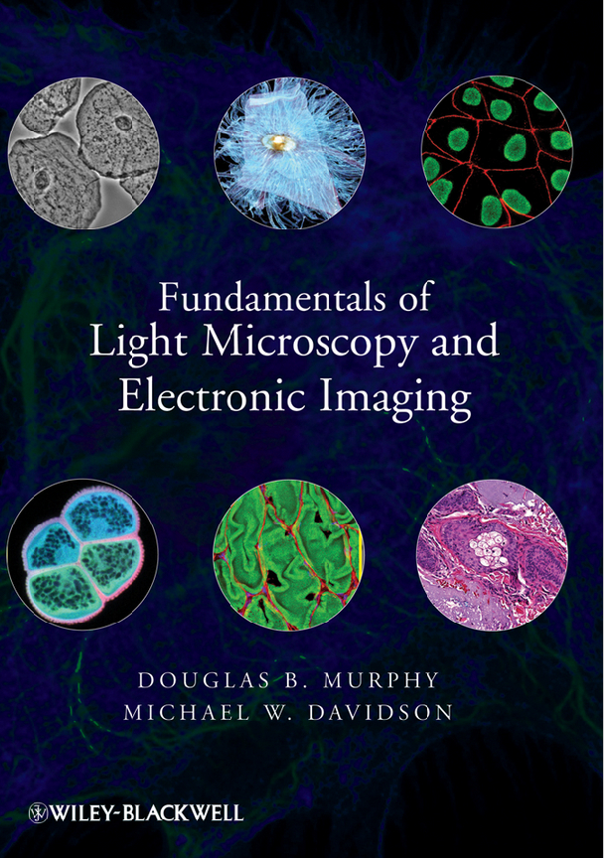
Excerpts from

Slide 3
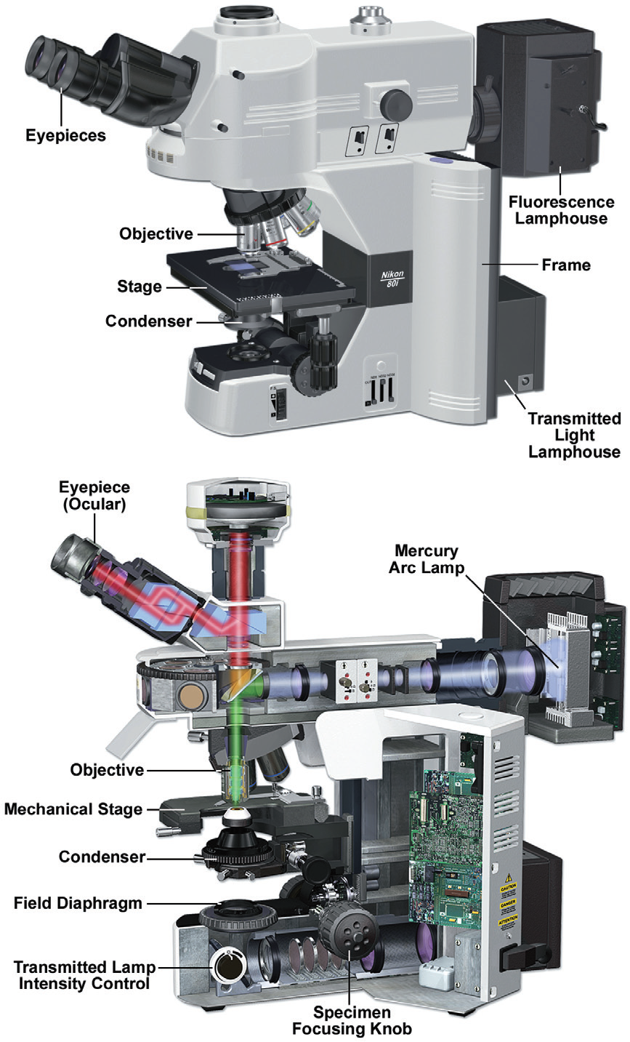
Multi-Function Light Microscope
Upright Stand Inverted Stand

Slide 4
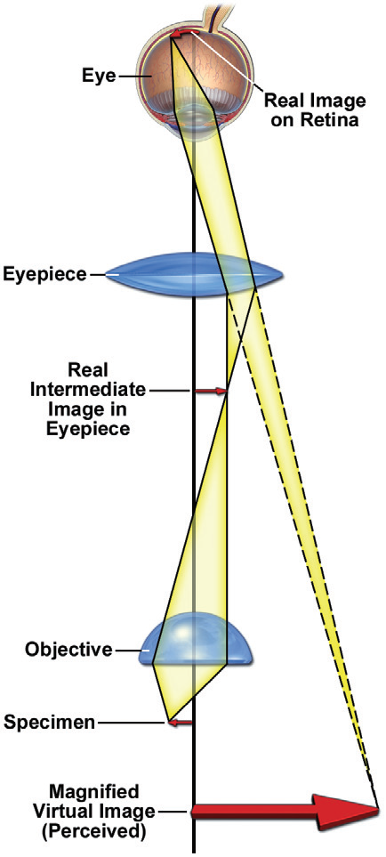
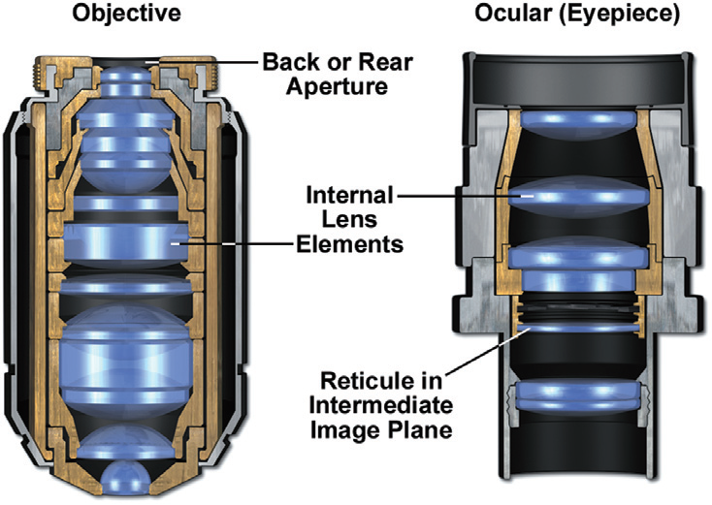

Slide 5
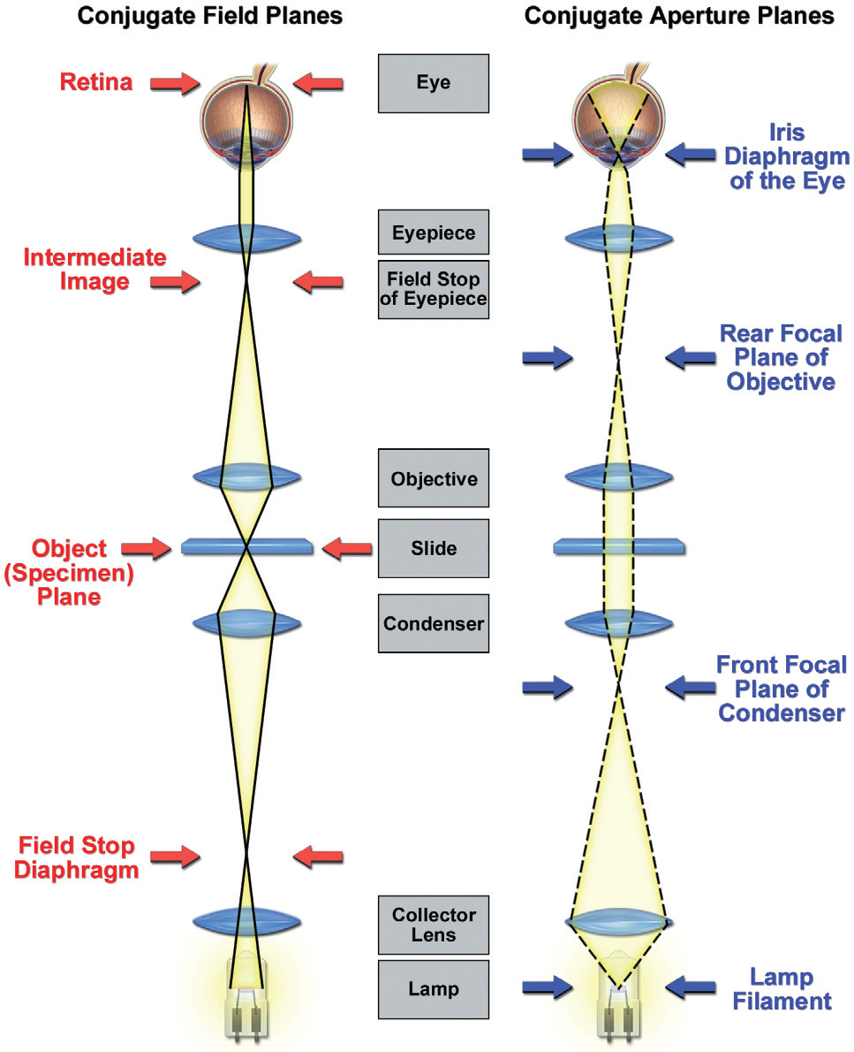

Slide 6
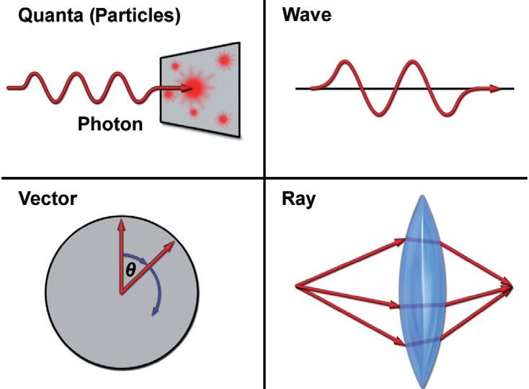
c = freq*wavelength
Energy = PlanksConstant*freq

Slide 7
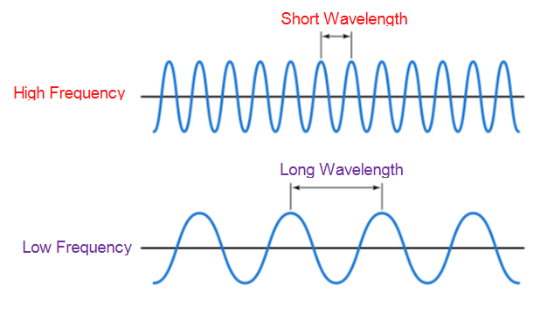
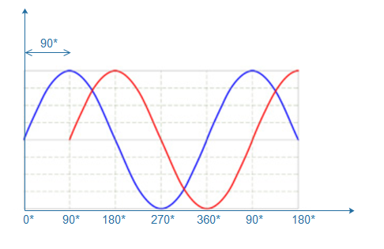
phase

Slide 8
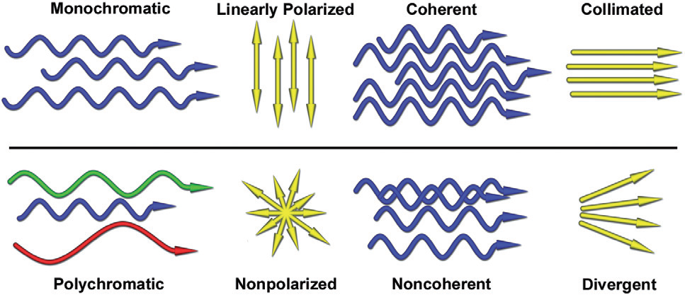
Types of Light
E vectors vibrate in parallel planes
Same phase
Coaxial
Same wavelength

Slide 9
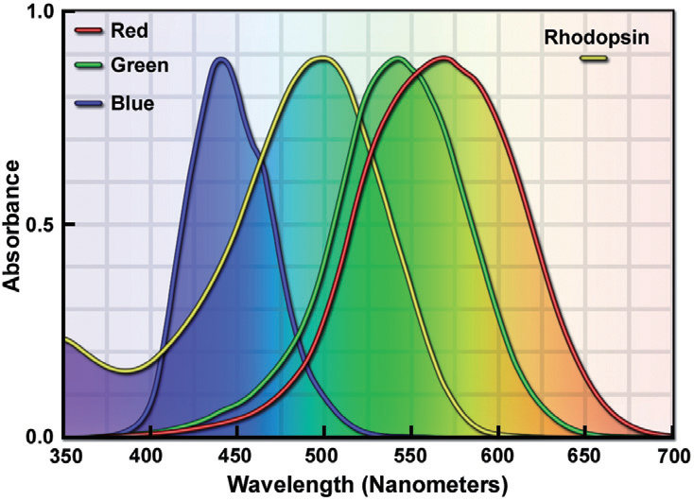
Rhodopsin in rod cells 40 time more sensitive than cone cells
Rods
Night
95%
Cones
Day
5%

Slide 10
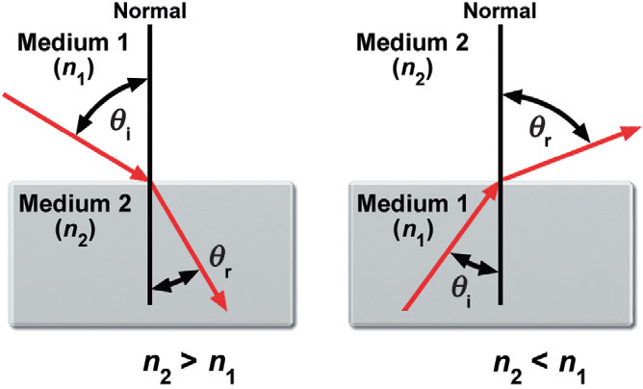
Refraction & Snell’s Law

Slide 11
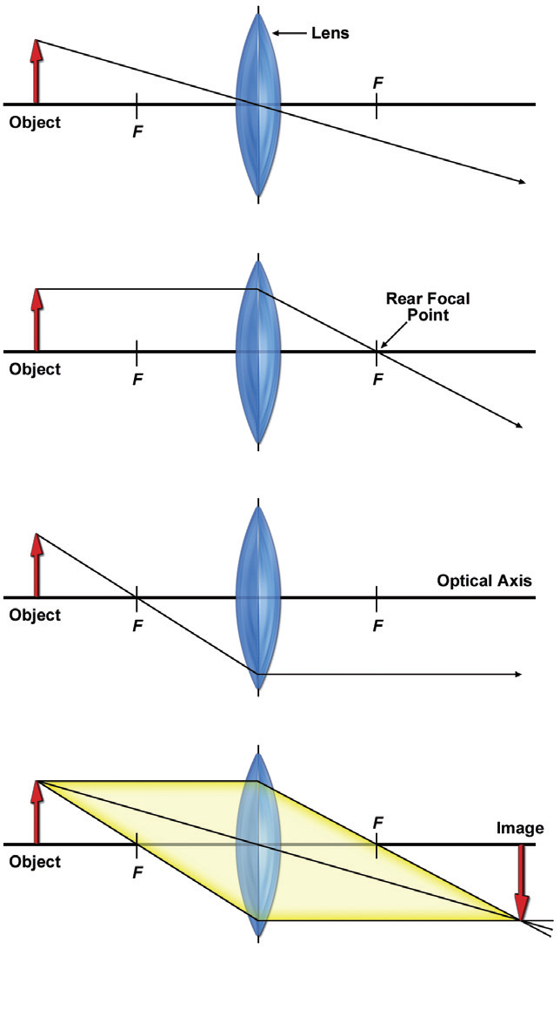
Ray Tracing for Thin Lens
(a) Ray passing through lens center remains un-deviated
(b) Ray parallel to optical axis passes through rear focal point.
(c) Ray passing through front focal point refracted parallel to optical axis.
(d) Intersection of two of three rays defines the image plane.

Slide 12
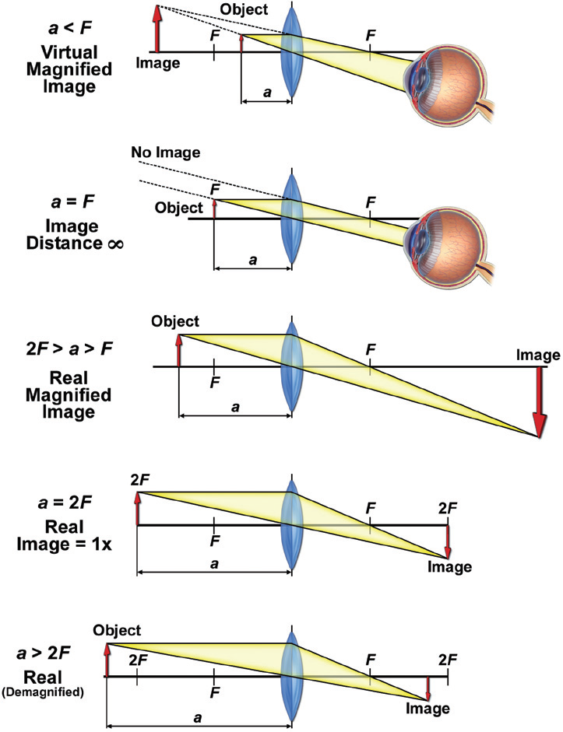
Microscope
Telescope
Microscope
Copy Lens

Slide 13
